Slide 1

CSE 163
Classes + HW4 + Logistics
Hunter Schafer

Slide 2
Class
A class lets you define a new object type by specifying what state and behaviors it has
A class is a blueprint that we use to construct instances of the object
Here is a full class
class Dog:
def __init__(self, name):
self.name = name
def bark(self):
print(self.name + ': Woof')
A class definition
An initializer that sets fields (state)
A method (behavior)

Slide 3
Building Dogs
d1 = Dog('Chester')
d2 = Dog('Scout')
d3 = d1
d4 = Dog('Chester')
d1
name: 'Chester'
d4
d2
name: 'Scout'
name: 'Chester'
d3

Slide 4
Identity vs Equality
“Is this object equal to this other object?”
The answer depends on what you mean by equal
Equality can mean one of two things
The objects have the same identity (i.e. same person)
The objects have the same value (e.g. same name)
l1 = [1, 2, 3]
l2 = [1, 2, 3]
l3 = l1
l1 == l2
l1 is l2
l1 is l3
# True, same values
# False, different object
# True, same object

Slide 5
Identity vs Equality
Let’s try this with our Dog class
d1 = Dog('Chester')
d2 = Dog('Chester')
d3 = d1
d1 is d2 # False
d1 is d3 # True
d1 == d2 # False?
Python doesn’t know by default what equality by value means
We have to tell it by implementing a __eq__ method

Slide 6
__eq__
class Dog:
def __init__(self, name):
self.name = name
def bark(self):
print(self.name + ': Woof')
def __eq__(self, other):
return self.name == other.name
d1 = Dog('Chester')
d2 = Dog('Chester')
d1 == d2 # True, same as d1.__eq__(d2)

Slide 7
Special Methods
The fact that you can use the same syntax for many classes is because of these “special methods”
Syntax | Method
x < y | x.__lt__(y)
x == y | x.__eq__(y)
x > y | x.__ge__(y)
print(x) | print(x.__repr__())
x[i] | x.__getitem__(i)
x[i] = v | x.__setitem__(i, v)

Slide 8
Search Engine
HW4 involves writing a search engine from scratch
This will mainly involve
Processing files
Writing classes
Can be a bit complicated at first, recommend reading over these slides and the entire spec first to see how the pieces fit together, then tackle each part
We have parts separated into a development strategy
A search engine involves two main components
An index to efficiently find results for a query
A ranking algorithm to order the results
We’ll describe the index and searching first even though you will implementing part of the ranking algorithm first on the assignment

Slide 9
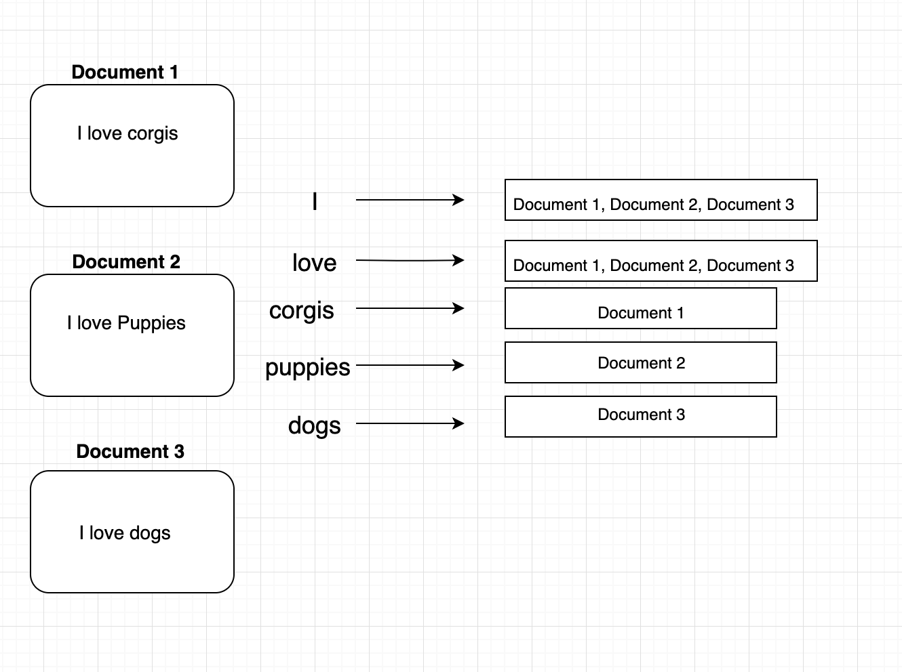
SearchEngine
SearchEngine: A class that manages which words appear in which document
Uses an inverted-index, to perform search

Slide 10
search
Part 1 - Single-word query
search(“love”)
Document 1
Document 2
Document 3
Part 2 - Multi-word query
search(“love corgis”)
Document 1
Document 2
Document 3
search(“corgis puppies”)
Document 1
Document 2

Slide 11
Document Ranking
Once we have a set of results, need rank them by relevance
Query: “the dogs”
Dogs are the most amazing pets. Dogs are way better than cats because they are the best pets.
dogs_rock.txt
a - An article...
aardvark - An animal...
...
avocado - A fruit…
...
dog - The best pet…
...
dictionary.txt
Which order should we rank the results?
If we did it by raw number of hits, this would almost always list the dictionary as the first result

Slide 12
TF-IDF
Raw counts fails because it favors long documents that have common words
Intuition, give higher weight to less common words and penalize common words like “the”
Score(“the dogs”, D) = TFIDF(“the”, D) + TFIDF(“dogs”, D)
TFIDF(t, D) = TF(t, D) * IDF(t)
TF(t, D) = (# of times t in D) / (# of words in D)
IDF(t) = (# of documents) / (# of documents that have t)

Slide 13
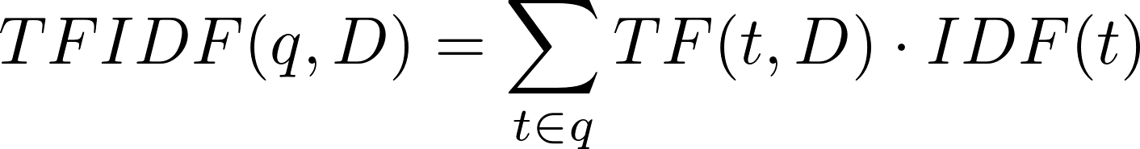
TF-IDF

Slide 14
How to compute TF-IDF
It would be inefficient to calculate all these values from scratch every time we get a new query
Instead, we will store all the information ahead of time
Takes memory and a little bit to build, but then queries are fast
Document class stores Term-Frequency information
SearchEngine class stores Inverse-Document-Frequency information

Slide 15
Testing
Testing this assignment can be tricky with the wikipedia dataset
It’s large, takes a few minutes to build the index
It’s hard to know what the answer “should be”
You are recommend to make your own directories of test text files
In order to turn all of this in, we are asking that you turn in a zip of your hw4 folder. Instructions on website.
It’s okay to directly inspect your private fields in tests
We will do this for the private methods we ask you to write

Slide 16
Development Strategy
Read the whole spec first
Take notes as you’re writing and try to make a mental map of how the pieces fit together
Write down any of the special method calls we tell you about in the spec and what they do so you know when you’ll use them
Planning up front can be very helpful with this project
You should probably still tackle the project in the order we suggested, but thinking about the whole thing is important

Slide 17
Sorting
Python has a built-in function called sorted
Not supported by many types by default, but you can use the key parameter to help
Key takes a function that takes an object and turns it into value that is sortable.
Python then sorts the list based on the key value for each value in the list.

Slide 18
Lambdas
It’s kind of annoying to have to define a whole function just for this. It would be nice if there was a shorthand syntax
def get_name(d):
return d.name
f = get_name
sorted(dogs, key=f)
f = lambda d: d.name
sorted(dogs, key=f)
sorted(dogs, key=lambda d: d.name)

Slide 19
Logistics
Exam 1 Materials Posted
Next week’s content, last thing on exam 1
Practice exam coming soon
Section problems, practice problems, homework great things to study.
Project information released
Part 0 due in 3 weeks
Part 0 - Find dataset and come up with research questions
Fast turn-around for Part 1 which is outlining your methodologies, motivations, and work-plan

Slide 20


Calendar
HW4 Due
Exam 1
HW5 Due
HW5 Due
Part 0
HW6 Due
Part 1

